Slide 1
WORK PROGRESS LOG
Meta Ad Performance
Dashboard
A step-by-step record of building the Power BI dashboard — from raw data to final report.
Adrij Das • Data Analyst Portfolio Project

Slide 2
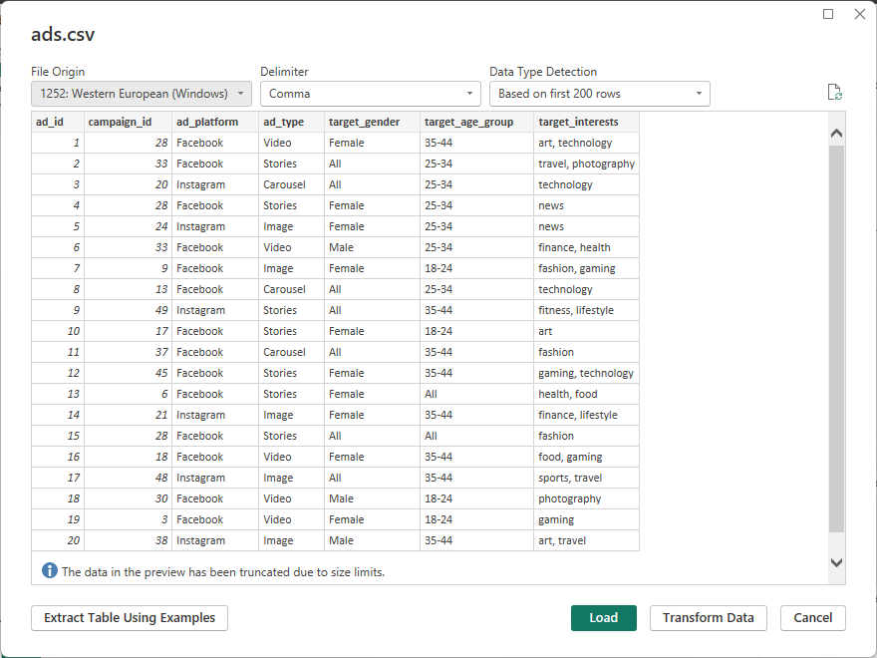
1
Load the Dataset in Power BI
Importing the raw source data to begin the build.
META AD PERFORMANCE DASHBOARD
STEP 01 / 08

Slide 3
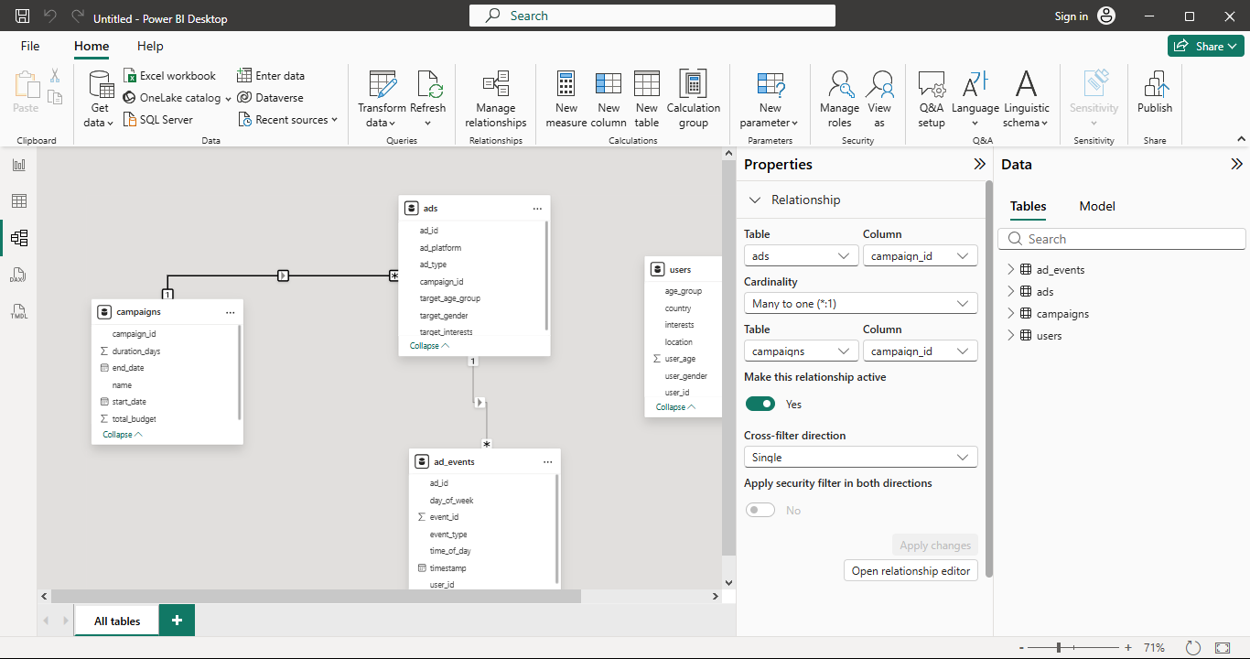
2
Build Relationships Between Tables
Connecting tables through the data model so they can be queried together.
META AD PERFORMANCE DASHBOARD
STEP 02 / 08

Slide 4
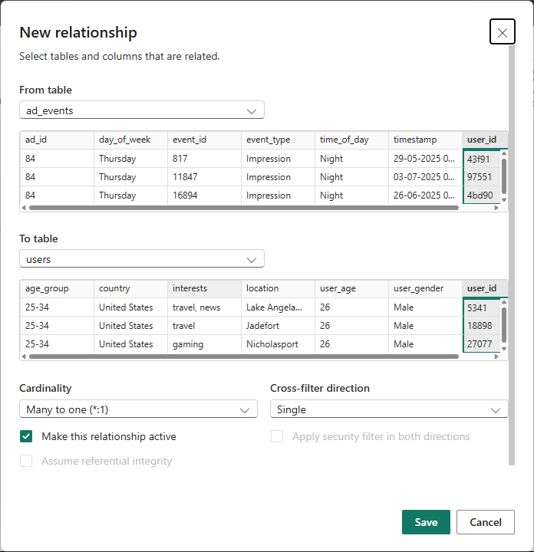
3
Link the ad_events and users Tables
Creating a new relationship to join campaign events with user records.
META AD PERFORMANCE DASHBOARD
STEP 03 / 08

Slide 5
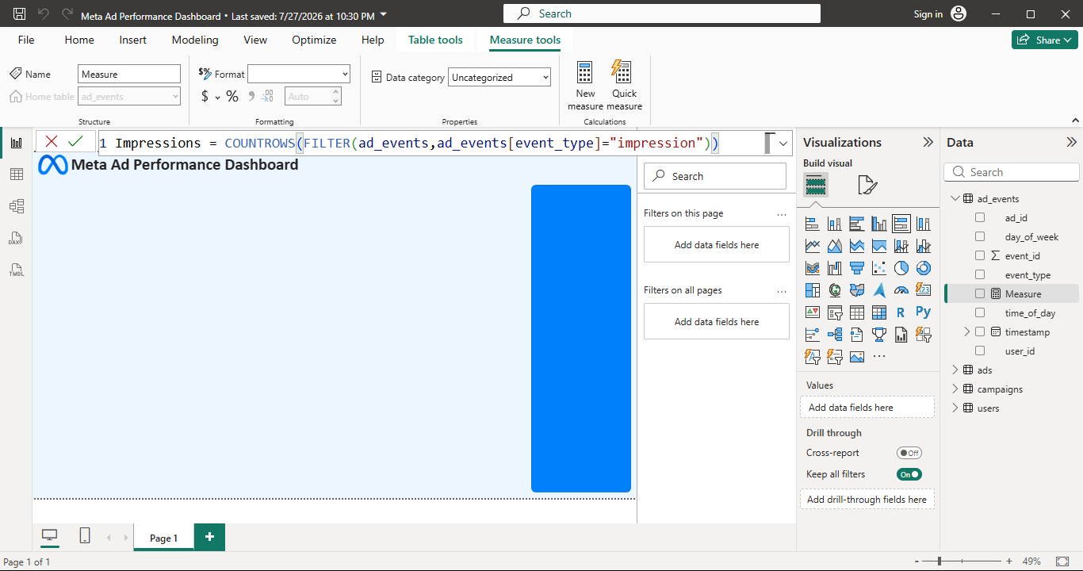
4
Create the DAX Measures
Writing the calculations the dashboard's visuals will run on.
META AD PERFORMANCE DASHBOARD
STEP 04 / 08

Slide 6
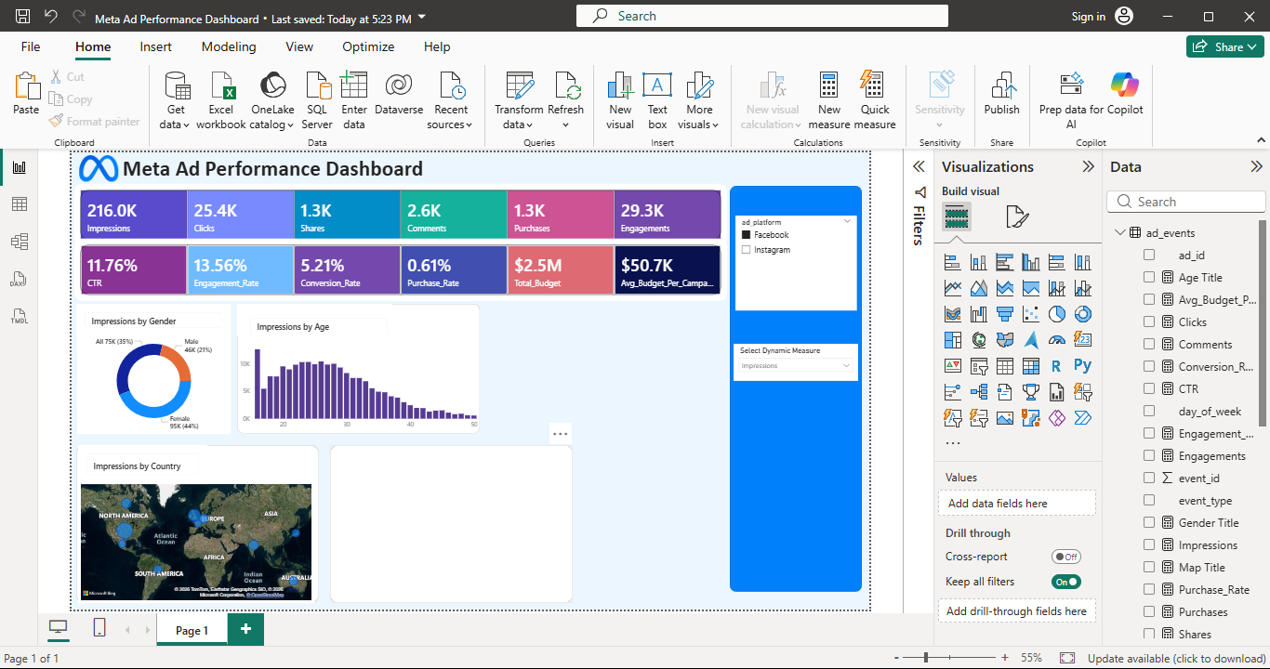
5
Build Out the Charts
Turning the modeled data into the report's core visuals.
META AD PERFORMANCE DASHBOARD
STEP 05 / 08

Slide 7
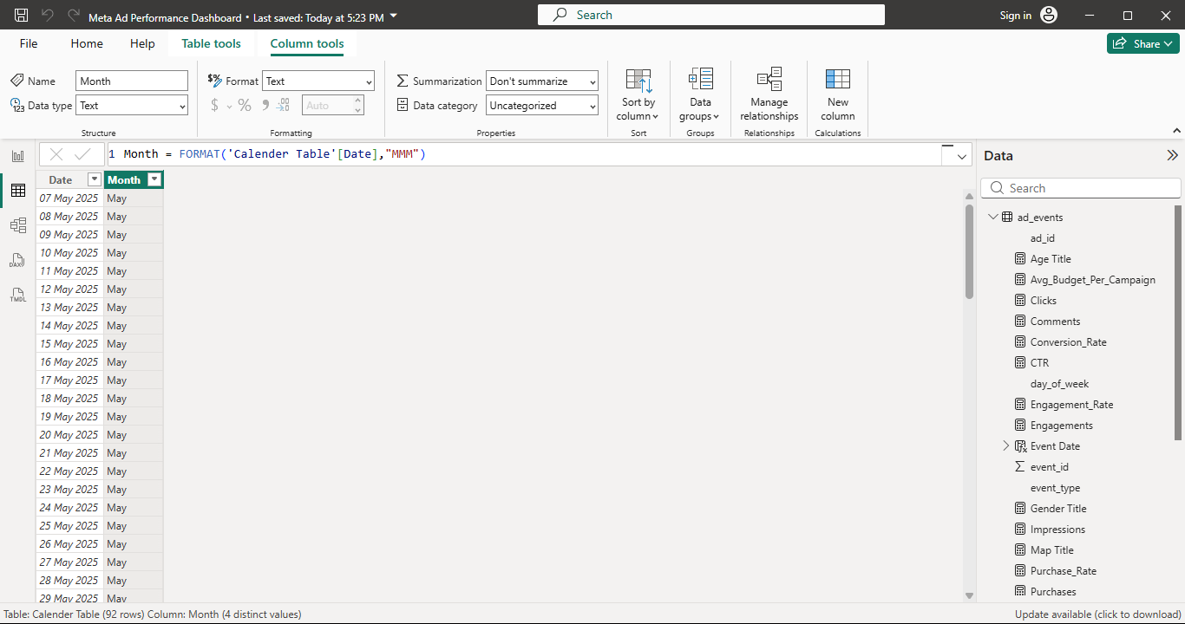
6
Extract Month from the Date Column
Deriving a month field to support time-based calculations.
META AD PERFORMANCE DASHBOARD
STEP 06 / 08

Slide 8
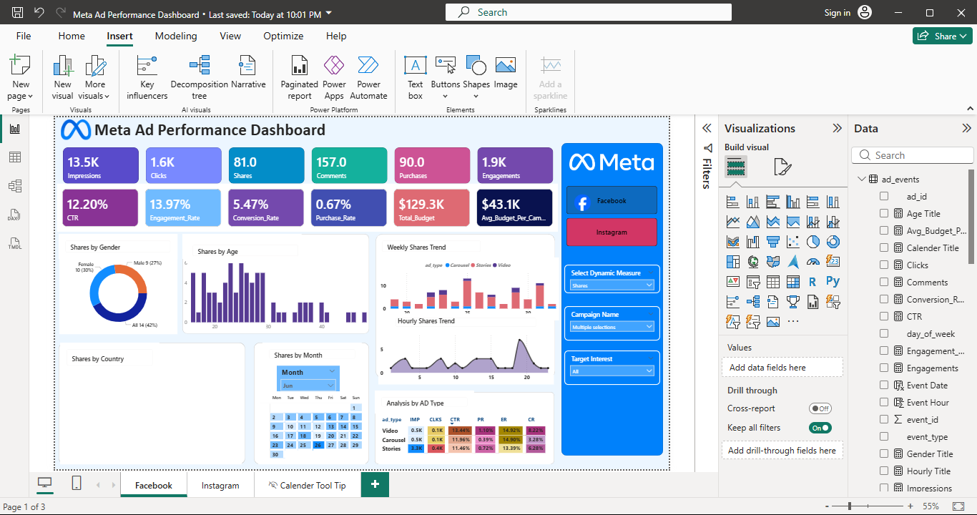
7
Continue Refining the Build
Mid-build state, still in progress.
META AD PERFORMANCE DASHBOARD
STEP 07 / 08

Slide 9
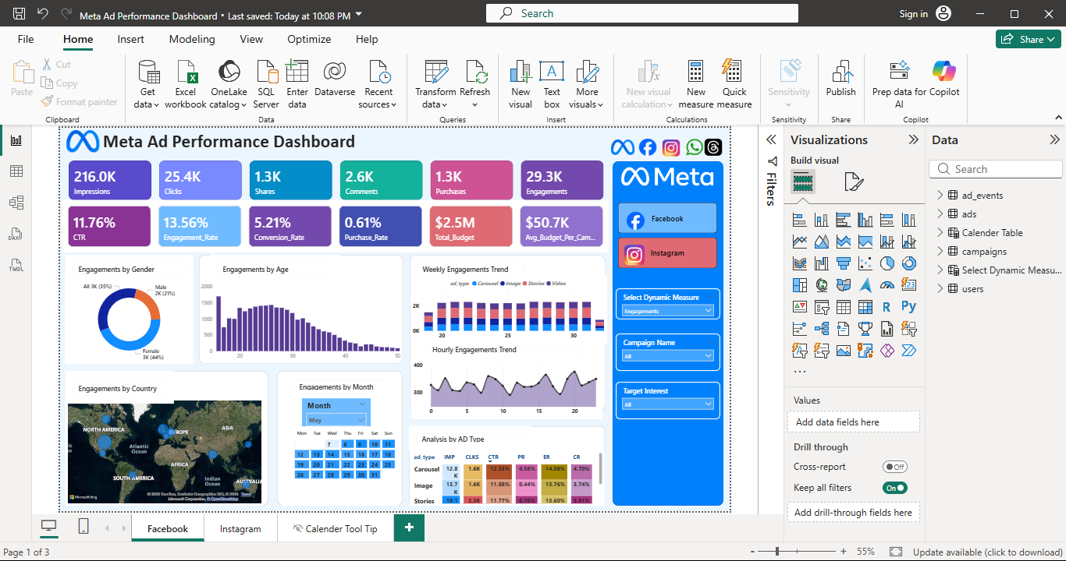
8
Final Touches on the Project
Polishing the report ahead of publishing.
META AD PERFORMANCE DASHBOARD
STEP 08 / 08

